Slide 1


DATA 225 Database Systems for Analytics September 11 Class Meeting
Department of Applied Data Science San Jose State University Fall 2023 Instructor: Ron Mak
www.cs.sjsu.edu/~mak

Slide 2
This Evening
Entity-relationship (ER) diagram (conceptual data model)
entities and attributes
relationships
Use of https://erdplus.com website.
Break
Relational schema (logical data model)
MySQL database (physical data model)

Slide 3
Conceptual Data Model
Visualize the requirements.
Build a conceptual data model.
Example: Entity-Relationship (ER) modeling
Draw ER diagrams.
Implementation independent: No dependencies on the logic of a particular database management system.
Example DBMS: Oracle, MySQL, etc.
Blueprint for the logical model.

Slide 4
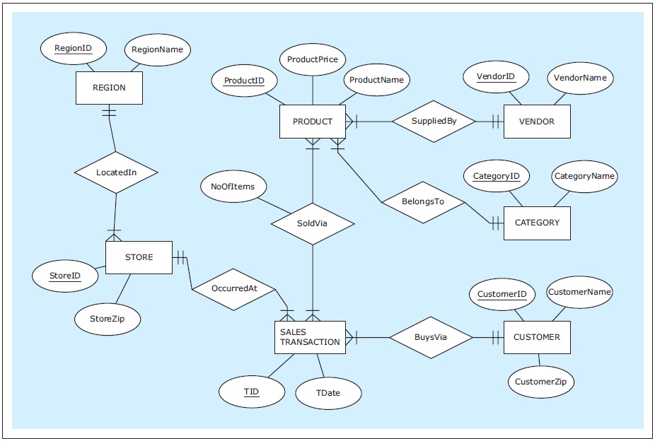
Example Conceptual Model: ER Diagram
A free online tool for drawing ER diagrams: https://erdplus.com
Create an account and you can save diagrams.
ZAGI Retail Company
Sales Department Database
Database Systems
by Jukić, Vrbsky, & Nestorov
Pearson 2014
ISBN 978-0-13-257567-6

Slide 5
Entities and Attributes
Entity
Represents a real-world concept.
Examples: customer, product, store, event, etc.
Data that the database stores.
Each entity represents multiple instances.
Example: A student entity represents many students.
Attribute
Characteristic of an entity that the database stores.
Examples (for a customer): name, address, id, etc.
A unique attribute of an entity has a value that is different for each instance of the entity.

Slide 6
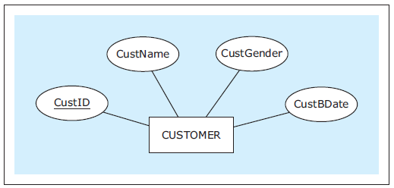
Entities and Attributes, cont’d
In an ER diagram, show an entity with a rectangle and its attributes with ovals.
Underline the unique attribute.
Database Systems
by Jukić, Vrbsky, & Nestorov
Pearson 2014
ISBN 978-0-13-257567-6

Slide 7
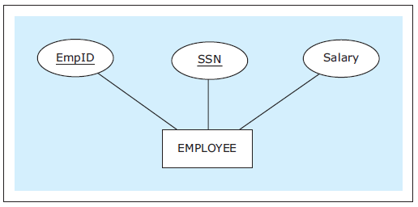
Entities and Attributes, cont’d
An entity can have multiple unique attributes.
Each one is called a candidate key.
Database Systems
by Jukić, Vrbsky, & Nestorov
Pearson 2014
ISBN 978-0-13-257567-6

Slide 8
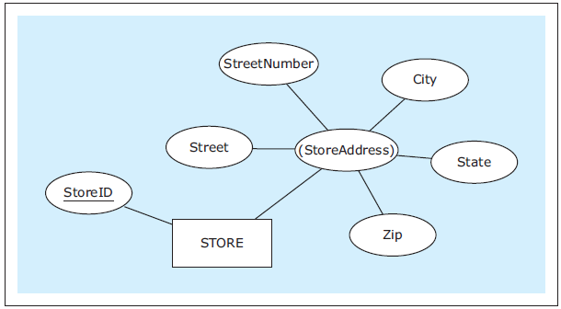
Composite Attributes
A composite attribute is composed of several attributes.
Parenthesize the name of the composite attribute.
Database Systems
by Jukić, Vrbsky, & Nestorov
Pearson 2014
ISBN 978-0-13-257567-6

Slide 9
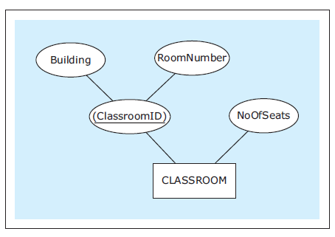
Composite Attributes, cont’d
An entity’s unique attribute can be composite.
Database Systems
by Jukić, Vrbsky, & Nestorov
Pearson 2014
ISBN 978-0-13-257567-6

Slide 10
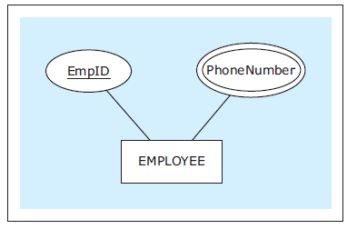
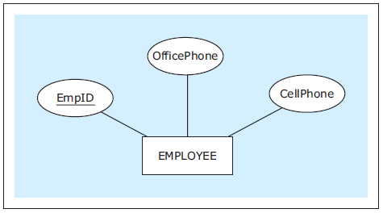
Multivalued Attributes
An entity instance can have multiple values for an attribute.
If the number of values is fixed, we can use separate attributes instead.
Database Systems
by Jukić, Vrbsky, & Nestorov
Pearson 2014
ISBN 978-0-13-257567-6

Slide 11
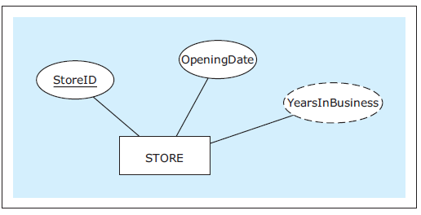
Derived Attributes
The value of a derived attribute is not stored.
It’s calculated from the values of the other attributes and additional data such as the current date.
Show with a dashed oval.
Database Systems
by Jukić, Vrbsky, & Nestorov
Pearson 2014
ISBN 978-0-13-257567-6

Slide 12
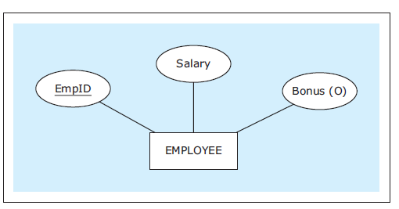
Optional Attributes
An optional attribute does not always have to have a value.
Indicate with (O).
Database Systems
by Jukić, Vrbsky, & Nestorov
Pearson 2014
ISBN 978-0-13-257567-6

Slide 13
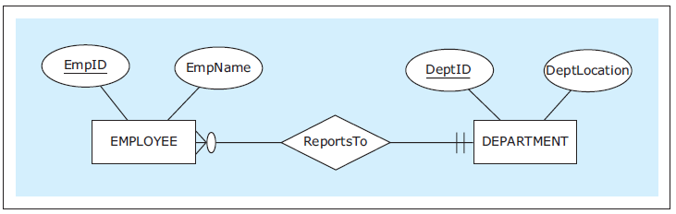
Relationships
Each entity in an ER diagram must be related to at least one other entity.
Show a relationship with a diamond and connect the diamond to the entities that are part of the relationship.
Database Systems
by Jukić, Vrbsky, & Nestorov
Pearson 2014
ISBN 978-0-13-257567-6

Slide 14
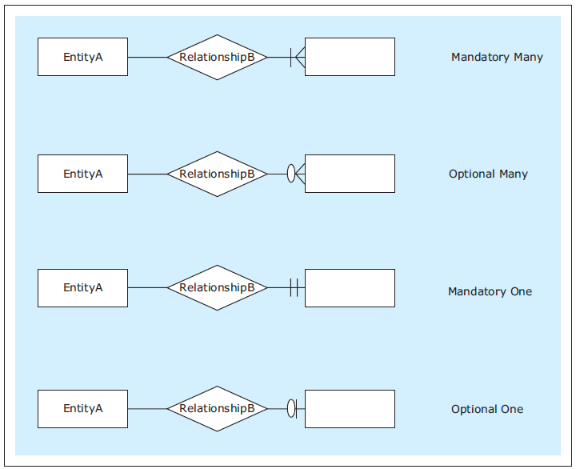
Relationship Cardinality
Show cardinality (how many instances of an entity) with symbols at the end of the relationship lines.
Maximum symbol closest to the entity.
Minimum symbol further away.
Zero, one, many
Database Systems
by Jukić, Vrbsky, & Nestorov
Pearson 2014
ISBN 978-0-13-257567-6

Slide 15
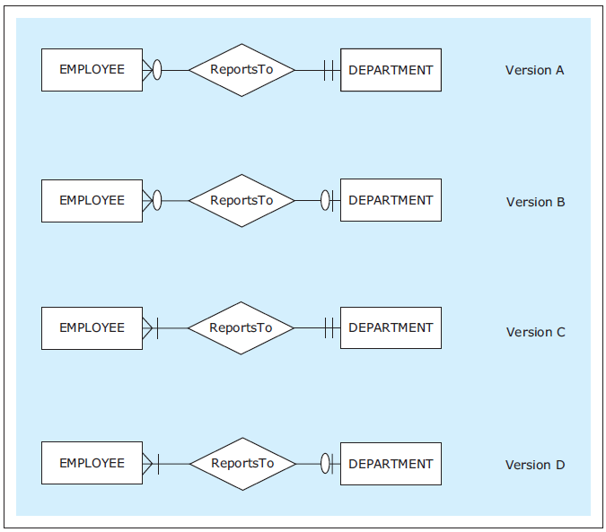
Relationship Cardinality, cont’d
Read each relationship in either direction in this order:
rectangle
diamond
cardinality
rectangle
Database Systems
by Jukić, Vrbsky, & Nestorov
Pearson 2014
ISBN 978-0-13-257567-6

Slide 16
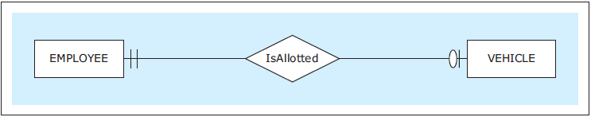
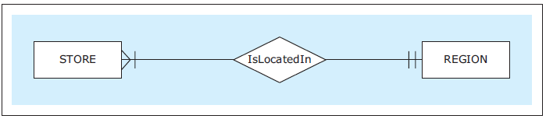
Types of Relationships
One-to-one (1:1)
One-to-many (1:M)
Each employee is allotted at most one vehicle.
Each vehicle is allotted to exactly one employee.
Each store is located in exactly one region.
Each region has located in it at least one (i.e., many) stores.
Database Systems
by Jukić, Vrbsky, & Nestorov
Pearson 2014
ISBN 978-0-13-257567-6

Slide 17
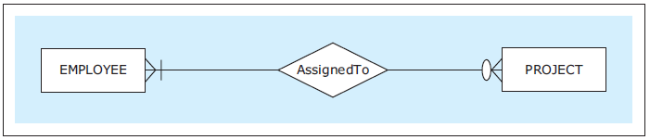
Types of Relationships, cont’d
Many-to-many (M:N)
Each employee is assigned to no or several (i.e., many) projects.
Each project has assigned to it at least one (i.e., many) employee.
Database Systems
by Jukić, Vrbsky, & Nestorov
Pearson 2014
ISBN 978-0-13-257567-6

Slide 18
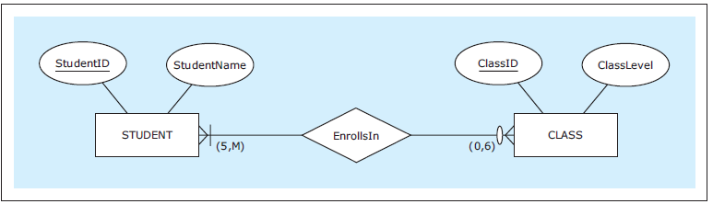
Exact Cardinalities
Indicate exact cardinalities with parenthesized minimum and maximum values.
Example: (2, 6)
Use M for a non-specific minimum or maximum.
Database Systems
by Jukić, Vrbsky, & Nestorov
Pearson 2014
ISBN 978-0-13-257567-6

Slide 19
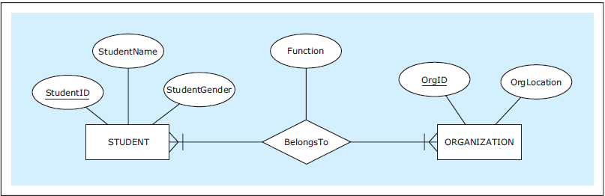
Relationship Attributes
An relationship can also have attributes.
Database Systems
by Jukić, Vrbsky, & Nestorov
Pearson 2014
ISBN 978-0-13-257567-6

Slide 20
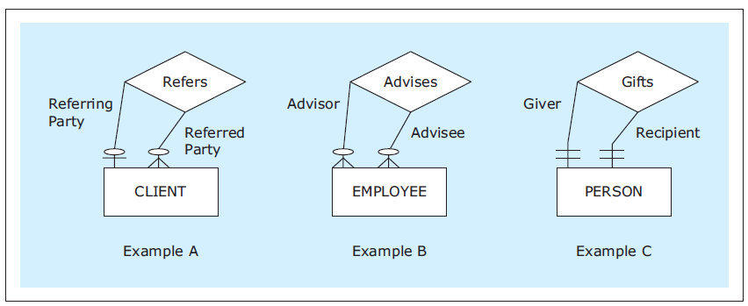
Unary Relationships
In a unary relationship, an entity is involved in a relationship with itself.
One instance has a relationship with another instance of the same entity.
You can indicate the relationship role.
Database Systems
by Jukić, Vrbsky, & Nestorov
Pearson 2014
ISBN 978-0-13-257567-6

Slide 21
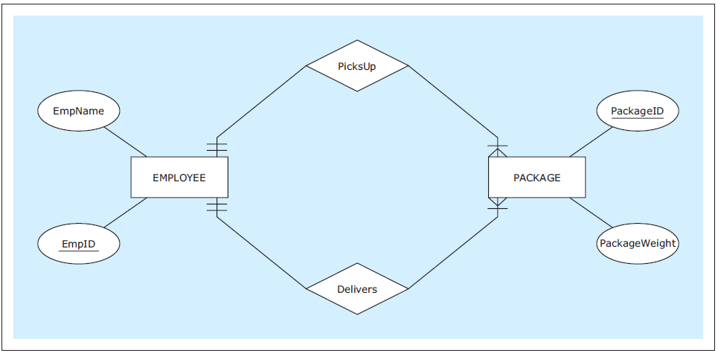
Multiple Relationships
Two entities can have multiple relationships with each other.
Database Systems
by Jukić, Vrbsky, & Nestorov
Pearson 2014
ISBN 978-0-13-257567-6

Slide 22
Weak Entities
A weak entity does not have its own unique attribute.
It only has a partial key.
Underline the partial key with dashes.
Therefore, it must be associated with an owner entity via an identifying relationship.
Indicate the weak entity and the identifying relationship with double borders.
The partial key and the owner attribute’s unique attribute uniquely identifies the weak entity.

Slide 23
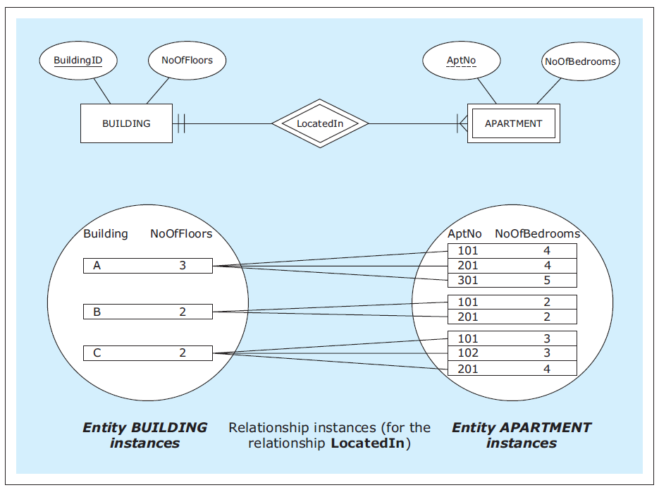
Weak Entities, cont’d
Database Systems
by Jukić, Vrbsky, & Nestorov
Pearson 2014
ISBN 978-0-13-257567-6

Slide 24
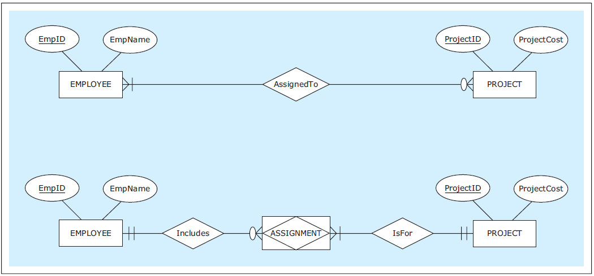
Associative Entities
An associative entity is an alternate way to depict a many-to-many (M:N) relationship.
Database Systems
by Jukić, Vrbsky, & Nestorov
Pearson 2014
ISBN 978-0-13-257567-6

Slide 25
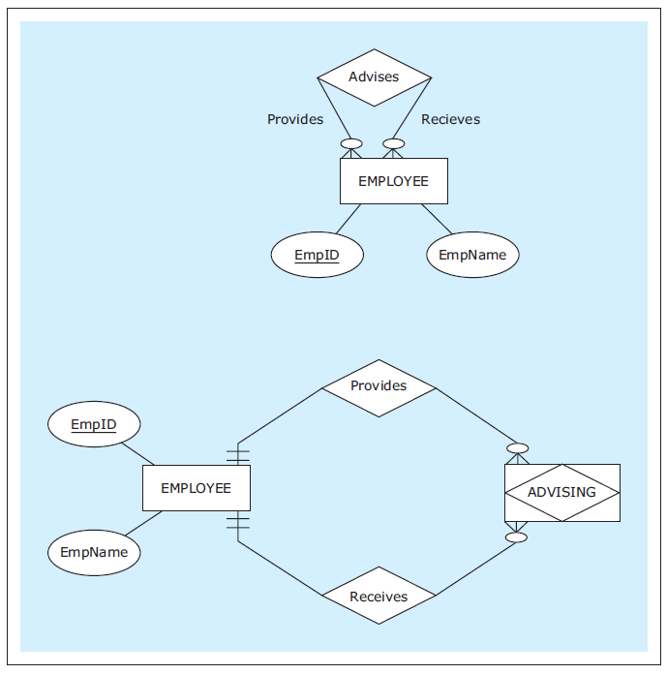
Associative Entities, cont’d
Associative entity for a unary M:N relationship.
Database Systems
by Jukić, Vrbsky, & Nestorov
Pearson 2014
ISBN 978-0-13-257567-6

Slide 26
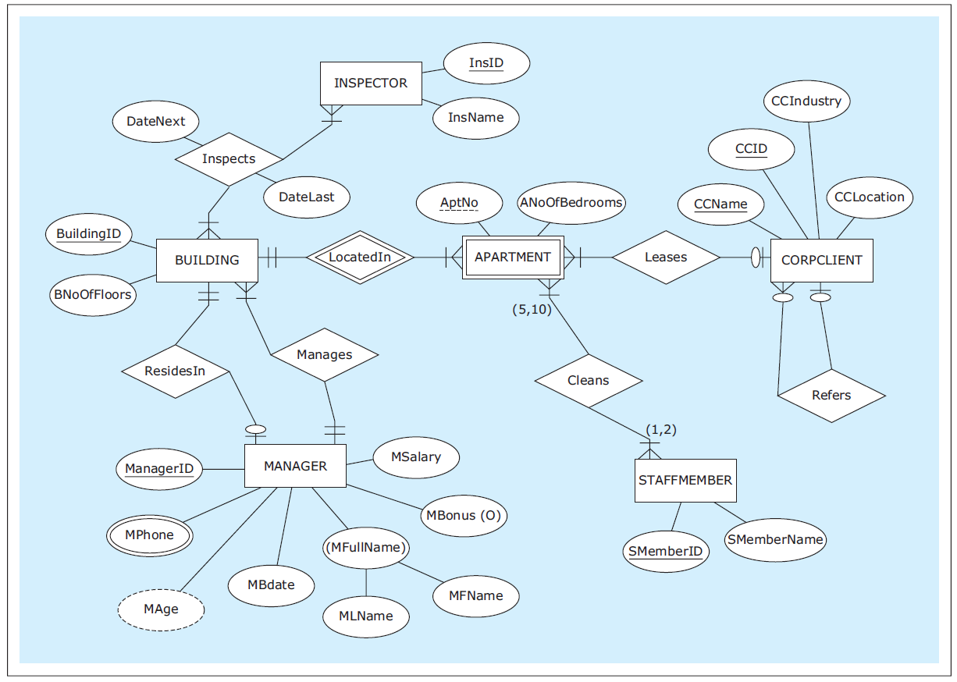
ER Diagram Example
HAFH Realty Company
Property Management Database
Database Systems
by Jukić, Vrbsky, & Nestorov
Pearson 2014
ISBN 978-0-13-257567-6

Slide 27
ERDPlus
Very capable online database design tool: https://erdplus.com
Create an ER diagram.
All the examples in these slides were generated using ERDPlus.
Automatic mapping to a relational schema.
Automatic export to SQL CREATE commands.
Create an account to save ER diagrams and relational schemas.
Demo

Slide 28
Break
Give ERDPlus a try!

Slide 29
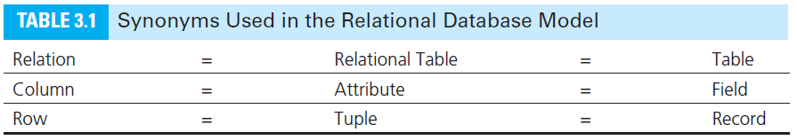
Logical Database Model
Map the ER diagram to a logical model represented as a relational schema.
Database Systems
by Jukić, Vrbsky, & Nestorov
Pearson 2014
ISBN 978-0-13-257567-6

Slide 30
Conditions for a Table to be a Relation
Each column must have a name.
Within a table, each column name must be unique.
All values in each column must be from the same (predefined) domain (i.e., same datatype).
Within a table, each row must be unique.
Within each row, each value in each column must be single-valued.
Multiple values of the content represented by the column are not allowed in any rows of the table.

Slide 31
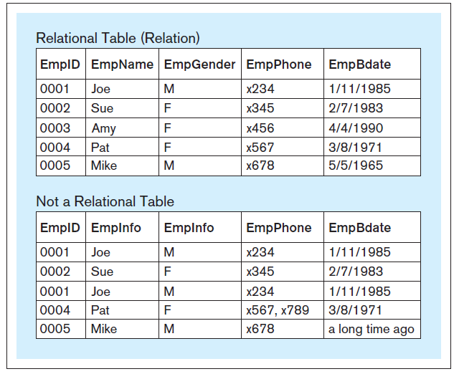
Relational vs. Non-Relational Tables
X
Database Systems
by Jukić, Vrbsky, & Nestorov
Pearson 2014
ISBN 978-0-13-257567-6

Slide 32
Additional Properties for a Relational Table
The order of columns is irrelevant.
The order of rows is irrelevant.

Slide 33
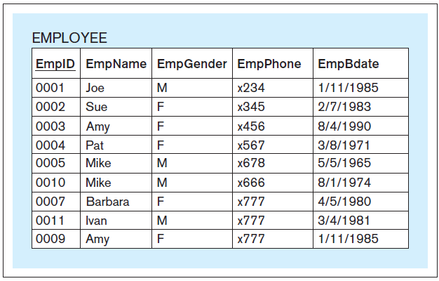
Primary Key
Each relation must have a primary key.
A column or set of columns whose value uniquely identifies each row.
Underline the primary key of the relational table.
Database Systems
by Jukić, Vrbsky, & Nestorov
Pearson 2014
ISBN 978-0-13-257567-6

Slide 34
Logical Database Model
Create the relational logical database model.
Later: Non-relational NoSQL models.
It’s usually straightforward to map an ER diagram to a relational model.
Create a relational schema.

Slide 35
Map Conceptual Model to Logical Model
From this ER diagram:
ZAGI Retail Company
Sales Department Database
Database Systems
by Jukić, Vrbsky, & Nestorov
Pearson 2014
ISBN 978-0-13-257567-6

Slide 36
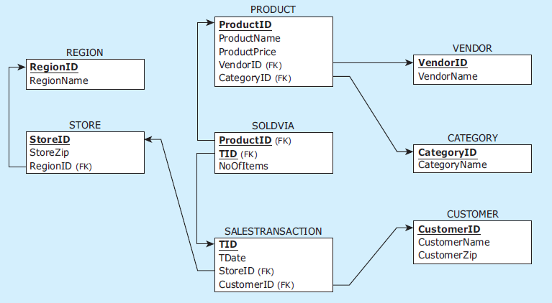
Logical Mapping as a Relational Schema
To this relational schema:
ZAGI Retail Company
Sales Department Database
Database Systems
by Jukić, Vrbsky, & Nestorov
Pearson 2014
ISBN 978-0-13-257567-6

Slide 37
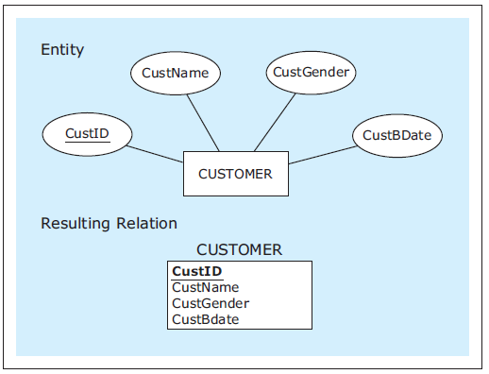
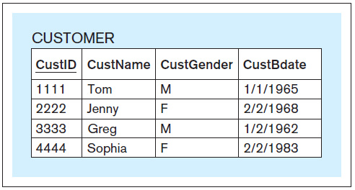
Mapping Entities
conceptual
logical
physical
Database Systems
by Jukić, Vrbsky, & Nestorov
Pearson 2014
ISBN 978-0-13-257567-6

Slide 38
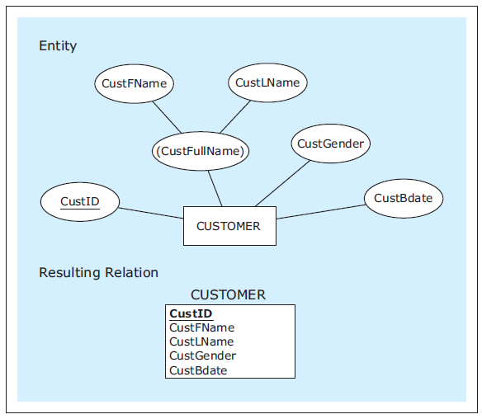
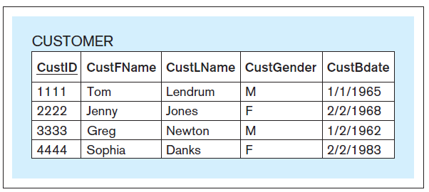
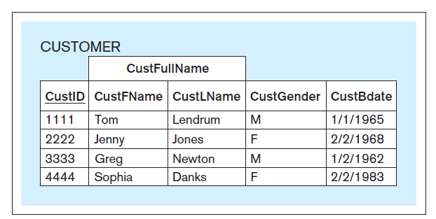
Mapping Entities, cont’d
As mapped.
Entity with a composite attribute.
As seen by a front-end application.
Database Systems
by Jukić, Vrbsky, & Nestorov
Pearson 2014
ISBN 978-0-13-257567-6

Slide 39
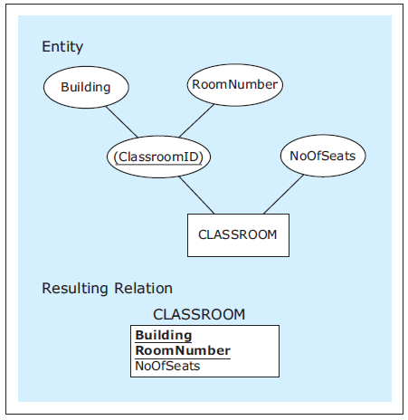
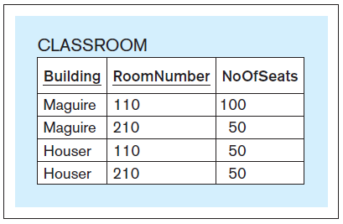
Mapping Entities, cont’d
Attribute with a
composite primary key.
Database Systems
by Jukić, Vrbsky, & Nestorov
Pearson 2014
ISBN 978-0-13-257567-6

Slide 40
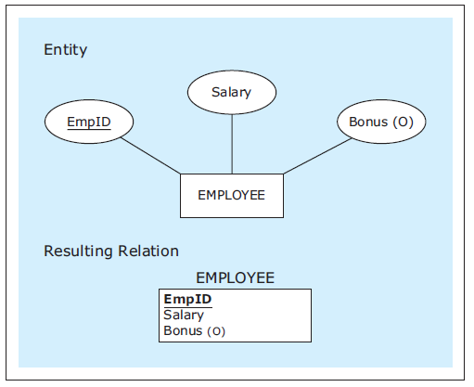
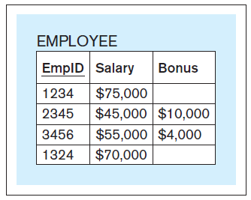
Mapping Entities, cont’d
Entity with an optional attribute.
Database Systems
by Jukić, Vrbsky, & Nestorov
Pearson 2014
ISBN 978-0-13-257567-6

Slide 41
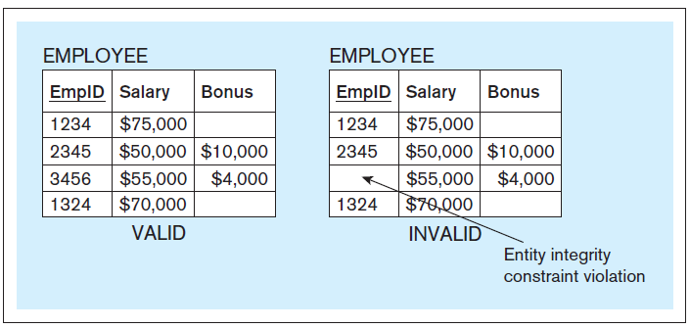
Entity Integrity Constraint
A primary key column of a relational table cannot have null (empty) values.
The database server will enforce entity integrity.
Database Systems
by Jukić, Vrbsky, & Nestorov
Pearson 2014
ISBN 978-0-13-257567-6

Slide 42
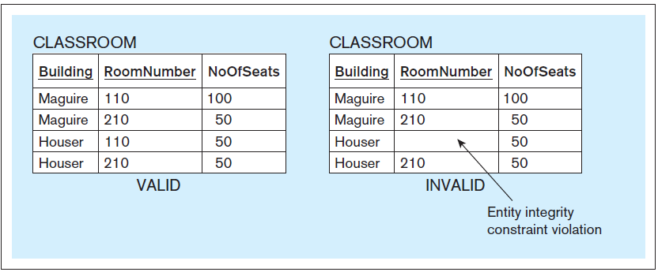
Entity Integrity Constraint, cont’d
Database Systems
by Jukić, Vrbsky, & Nestorov
Pearson 2014
ISBN 978-0-13-257567-6

Slide 43
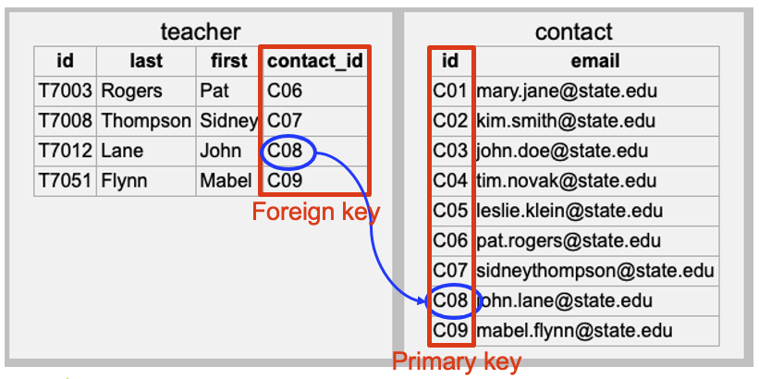
Foreign Keys
A foreign key is a column in a table that refers to a primary key column in another table.
In a relational schema, draw an arrow from the foreign key to the corresponding primary key.
CREATE TABLE teacher
(
id VARCHAR NOT NULL,
last VARCHAR NOT NULL,
first VARCHAR NOT NULL,
contact_id VARCHAR NOT NULL,
PRIMARY KEY (id),
FOREIGN KEY (contact_id) REFERENCES contact(id)
)

Slide 44
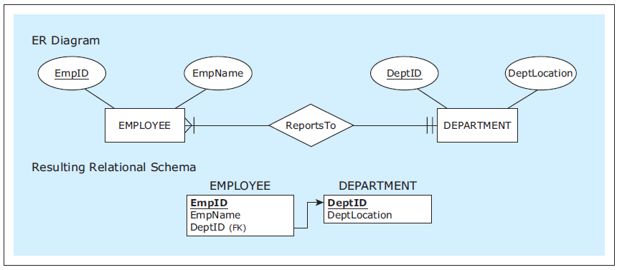
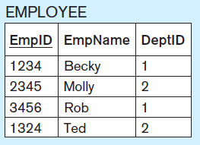
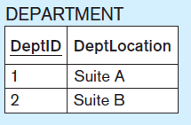
Mapping 1:M Relationships
Mandatory
participation
on both sides.
In a 1:M relationship,
the foreign key is
always on the M side.
The foreign key on the M side
of the 1:M relationship
(EMPLOYEE) corresponds to
the primary key on the 1 side
(DEPARTMENT).
Database Systems
by Jukić, Vrbsky, & Nestorov
Pearson 2014
ISBN 978-0-13-257567-6

Slide 45
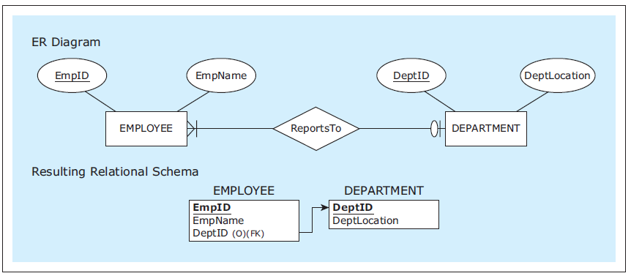
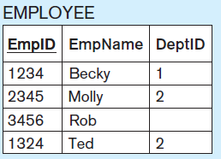
Mapping 1:M Relationships, cont’d
Optional participation
on the 1 side.
Database Systems
by Jukić, Vrbsky, & Nestorov
Pearson 2014
ISBN 978-0-13-257567-6

Slide 46
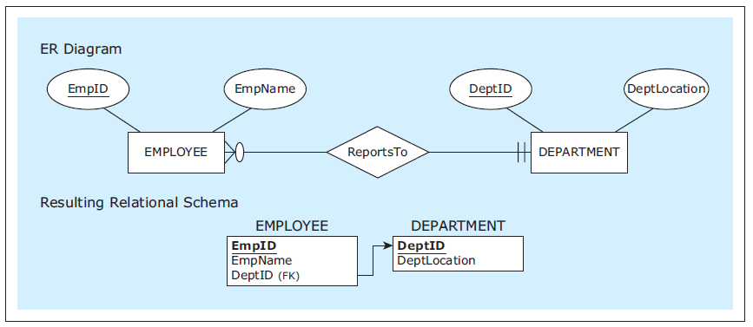
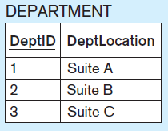
Mapping 1:M Relationships, cont’d
Optional participation
on the M side.
Database Systems
by Jukić, Vrbsky, & Nestorov
Pearson 2014
ISBN 978-0-13-257567-6

Slide 47
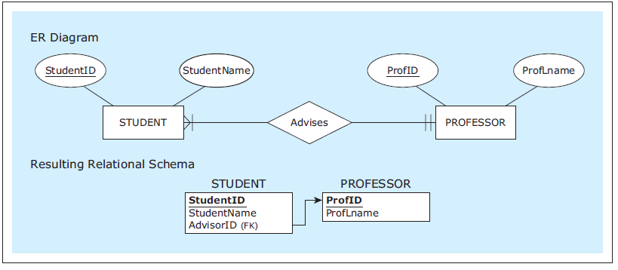
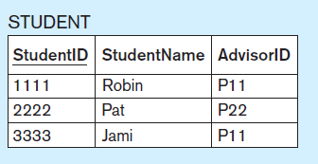
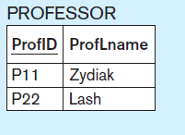
Mapping 1:M Relationships, cont’d
Rename a foreign key
to better reflect the
role of a relationship.
Database Systems
by Jukić, Vrbsky, & Nestorov
Pearson 2014
ISBN 978-0-13-257567-6

Slide 48
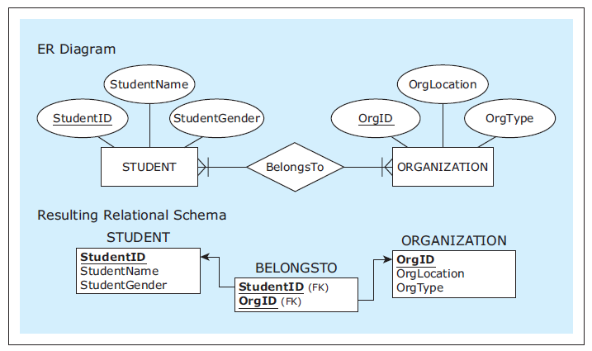



Mapping M:N Relationships
Use the
linking table
BELONGSTO
with two
foreign keys.
AKA:
bridge relation
or join table.
A M:N relationship
requires a
linking table.
Database Systems
by Jukić, Vrbsky, & Nestorov
Pearson 2014
ISBN 978-0-13-257567-6

Slide 49



Mapping M:N Relationships, cont’d
Optional
participation
on both sides.
Database Systems
by Jukić, Vrbsky, & Nestorov
Pearson 2014
ISBN 978-0-13-257567-6

Slide 50


Mapping M:N Relationships, cont’d
Relationship
with an
attribute.
Database Systems
by Jukić, Vrbsky, & Nestorov
Pearson 2014
ISBN 978-0-13-257567-6

Slide 51
Mapping 1:1 Relationships
Map 1:1 relationships similarly to 1:M relationships.
One table will have a foreign key pointing to the primary key of the other table.
It can be an arbitrary choice of which table has the foreign key.
Make the choice that is most intuitive or efficient.

Slide 52


Mapping 1:1 Relationships, cont’d
Table VEHICLE has the foreign key.
Database Systems
by Jukić, Vrbsky, & Nestorov
Pearson 2014
ISBN 978-0-13-257567-6

Slide 53

Referential Integrity Constraint
The value of a foreign key must either:
Match one of the values of the primary key in the referred table.
Be null.
The database server will enforce referential integrity.
Database Systems
by Jukić, Vrbsky, & Nestorov
Pearson 2014
ISBN 978-0-13-257567-6

Slide 54
Physical Database Model
The physical model is the actual database implementation.
Map the logical model (relational schema) to relational database tables.
Later: NoSQL systems
SQL commands to create, delete, modify, and query database structures.
ERDPlus will export CREATE commands.

Slide 55
Mapping Example: ER Diagram
From this ER diagram (conceptual model):
ZAGI Retail Company
Sales Department Database
Database Systems
by Jukić, Vrbsky, & Nestorov
Pearson 2014
ISBN 978-0-13-257567-6

Slide 56
Mapping Example: Relational Schema
To this relational schema (logical model):
ZAGI Retail Company
Sales Department Database
Database Systems
by Jukić, Vrbsky, & Nestorov
Pearson 2014
ISBN 978-0-13-257567-6

Slide 57

Mapping Example: Database Tables
To this database (physical model ):
ZAGI Retail Company
Sales Department Database
ZAGIsales.sql
Database Systems
by Jukić, Vrbsky, & Nestorov
Pearson 2014
ISBN 978-0-13-257567-6

Slide 58
ERDPlus Demo
Create the ER diagram for a simple database.
Map it to a relational schema.
Generate the SQL CREATE commands to recreate the database.

Slide 59
Relational Database Constraints
A constraint is a rule that a relational database must satisfy in order to be valid.
Two types of constraints:
implicit constraints
user-defined constraints

Slide 60
Implicit RDB Constraints
Each relation (table) in a relational schema must have a unique name.
For each relation:
Each column name must be unique.
Each row must be unique.
Each column of each row must be single-valued.
Domain constraint: All values in a column must be from the same predefined domain (i.e., datatype)
The column order is irrelevant.
The row order is irrelevant.

Slide 61
Implicit RDB Constraints, cont’d
Primary key constraint: Each relation must have a primary key (a column or set of columns) whose value is unique for each row.
Entity integrity constraint: No primary key column can have a null value.
Referential integrity constraint: In each row containing a foreign key, either the value of the foreign key must match one of the values of the primary key of the referred table, or the foreign key is null.

Slide 62
User-Defined RDB Constraints
Optional attributes
Mandatory foreign key
Example: Each employee must report to a department.
Exact cardinalities
Example: A student can take at most 5 classes.
Business rules
Usually enforced by front-end applications.
Example: Each organization must have both male and female students.

Slide 63




User-Defined RDB Constraints, cont’d
Database Systems
by Jukić, Vrbsky, & Nestorov
Pearson 2014
ISBN 978-0-13-257567-6

Slide 64
ER Modeling and Relational Modeling
Why not skip ER modeling and go directly to logical modeling (creating relational schemas)?
ER modeling is better for visualizing requirements.
Certain concepts can be visualized graphically only in an ER diagram.
A conceptual model (ER diagram) is better for communication and documentation.

Slide 65
Assignment #3: Data Modeling
Use the online ERDPlus tools at https://erdplus.com to create an ER diagram (conceptual model).
Map the ER diagram to a relational schema (logical model).
Export SQL CREATE commands to create the database (physical model).
Use MySQL Workbench to create an EER (extended entity-relationship) diagram.

Slide 66

Assignment #3, cont’d
MySQL Workbench can “reverse engineer” a schema (database) and generate an EER diagram.
https://medium.com/@tushar0618/how-to-create-er-diagram-of-a-database-in-mysql-workbench-209fbf63fd03

